Slide 1


Slide 2
Մաս 1
Վեկտորներ
Notes:
Start

Slide 3

Notes:
About linear algebra

Slide 4
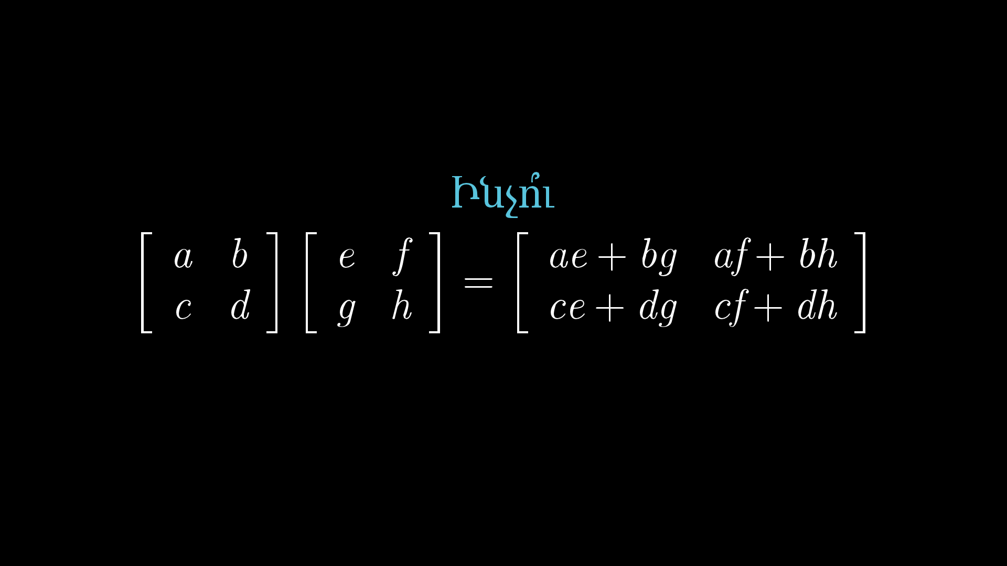
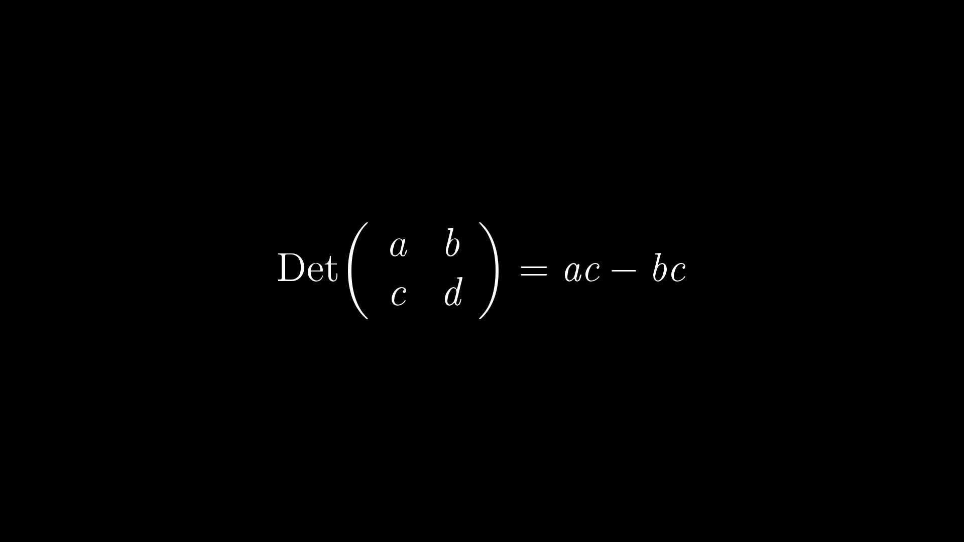
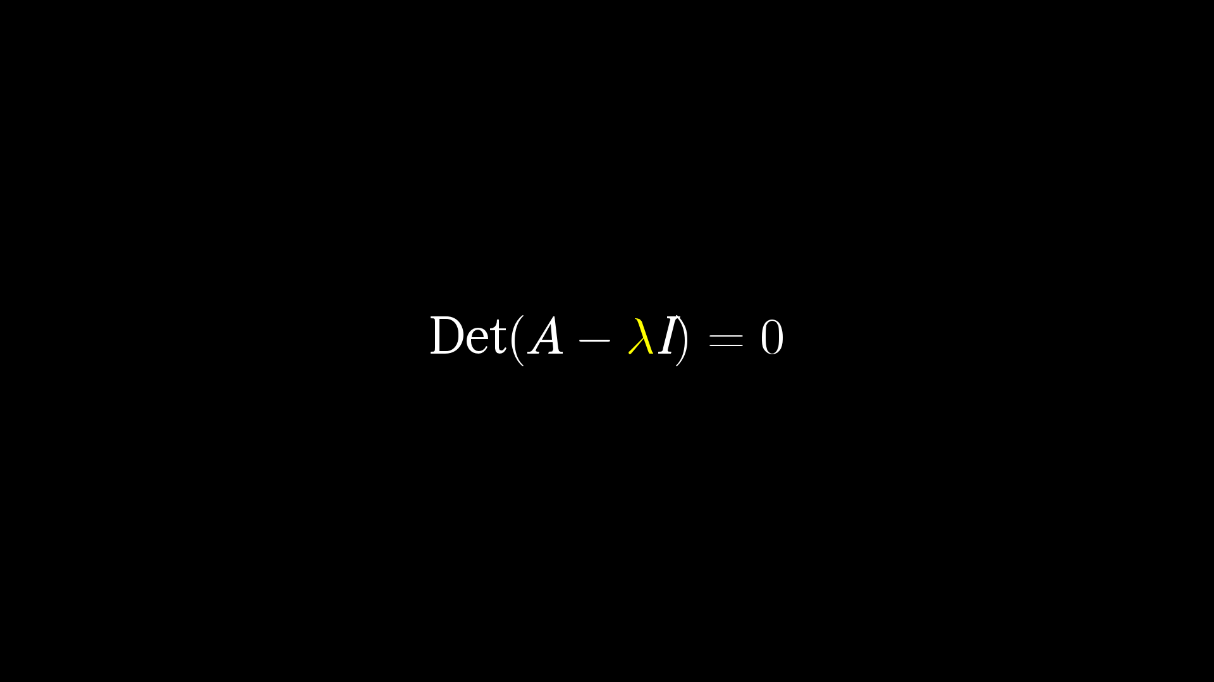
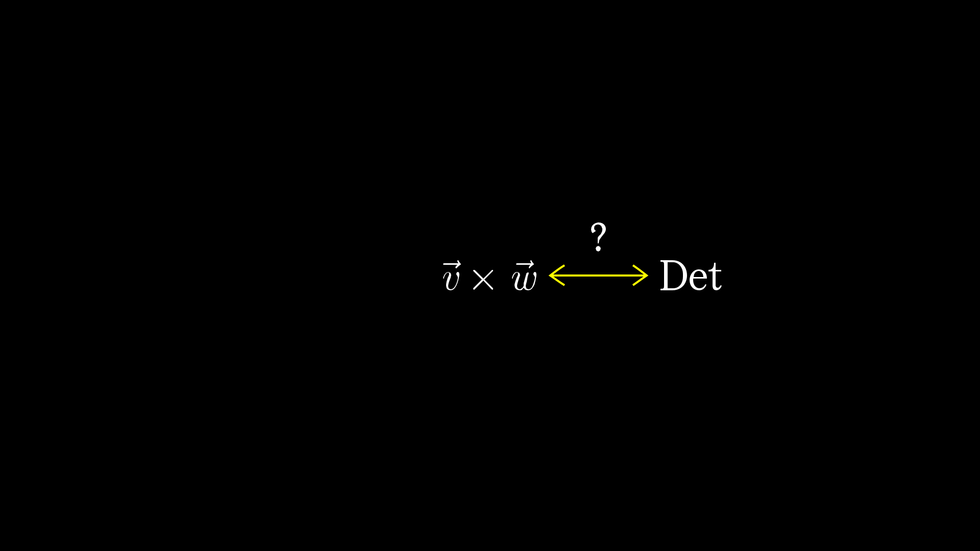
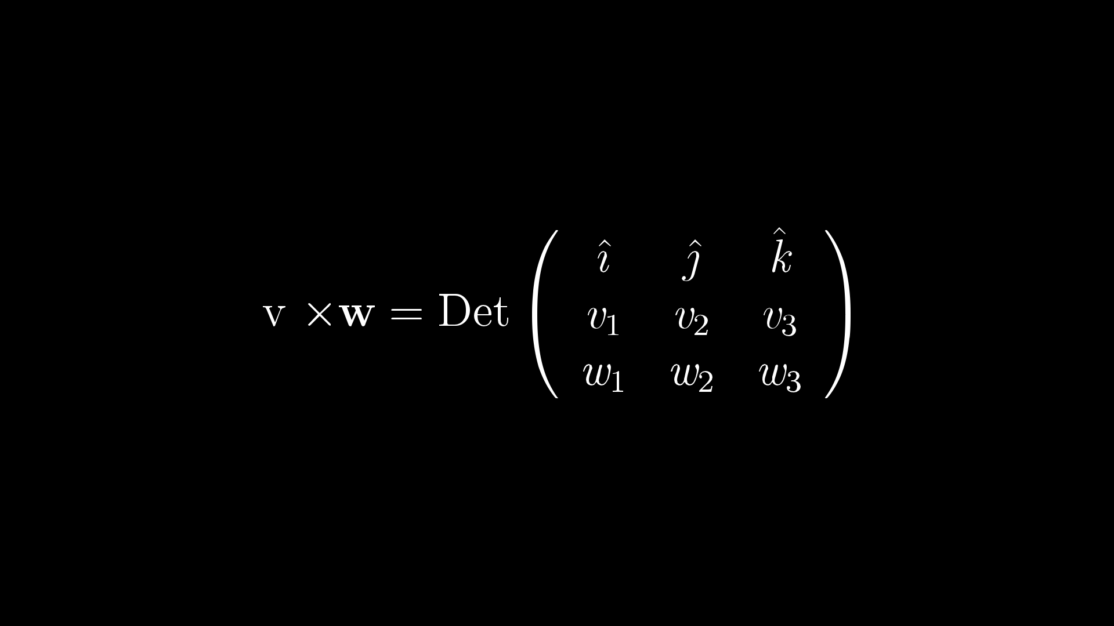
Notes:
Students do not understand
Geometric intuition

Slide 5
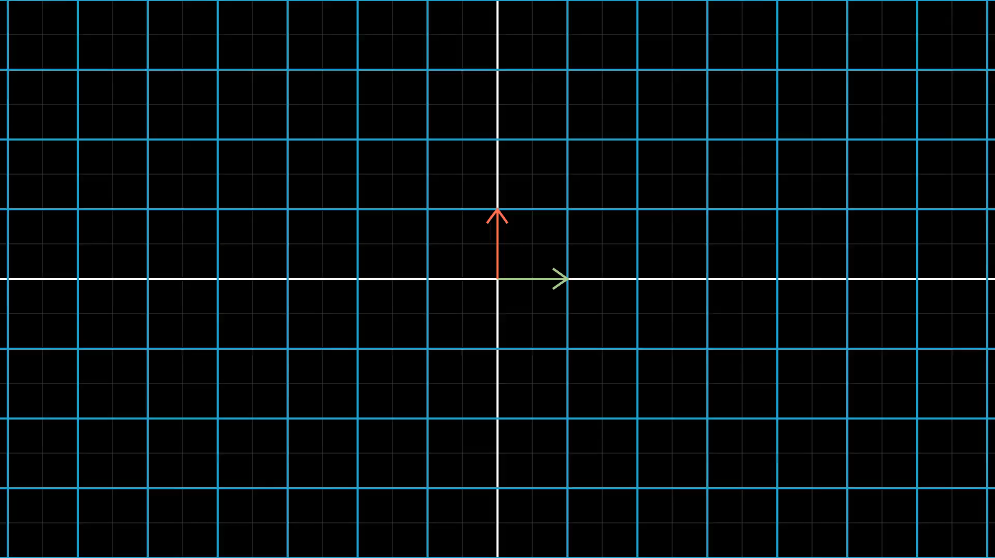
Notes:
Nice animations

Slide 6
Notes:
Sin aproximation

Slide 7
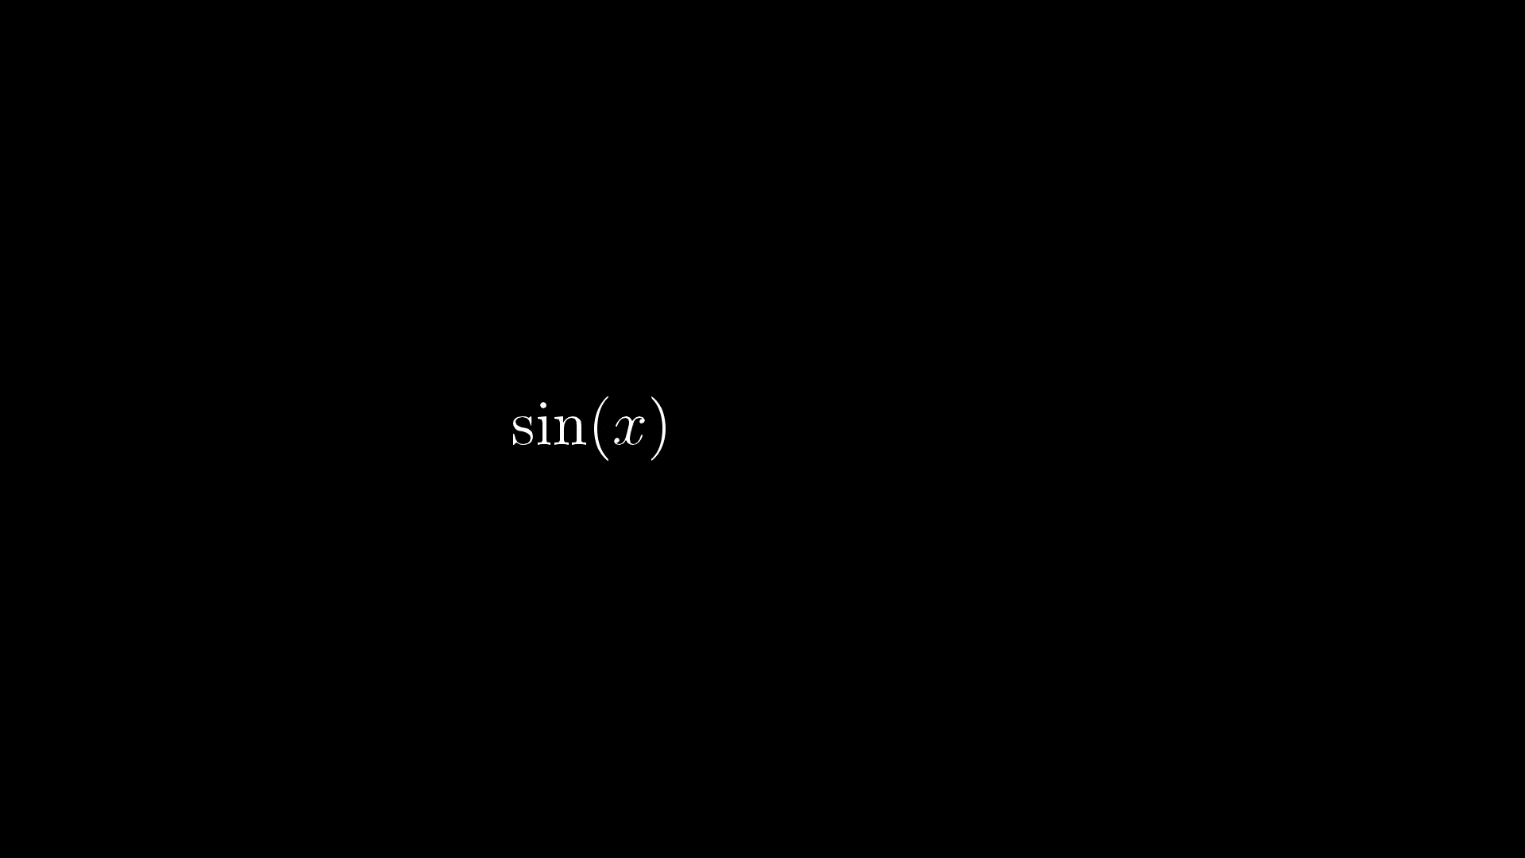
Notes:
Loose connection to riangles

Slide 8
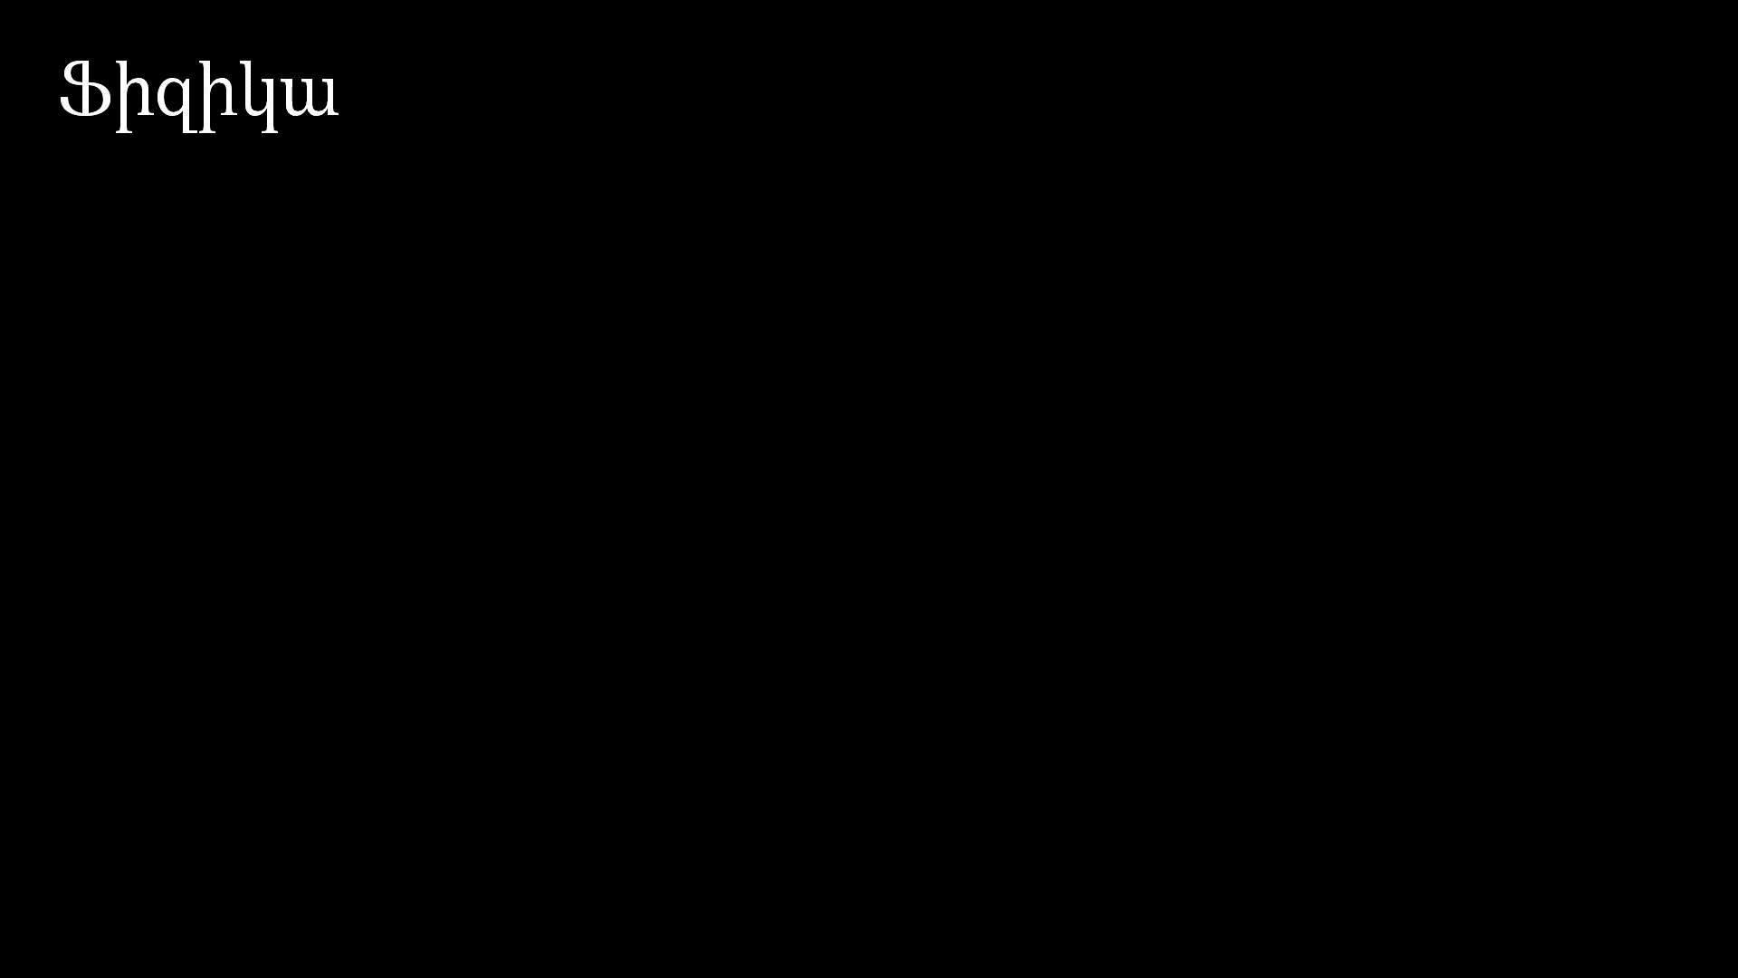
Notes:
Physics example

Slide 9
Notes:
Linalg pyramid

Slide 10
Notes:
What is vector

Slide 11
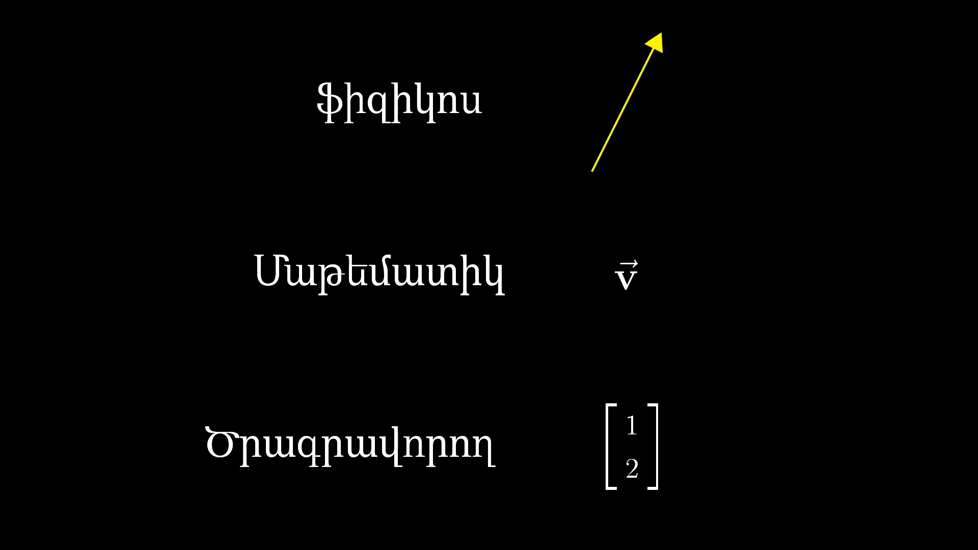
Notes:
Different conceptions

Slide 12
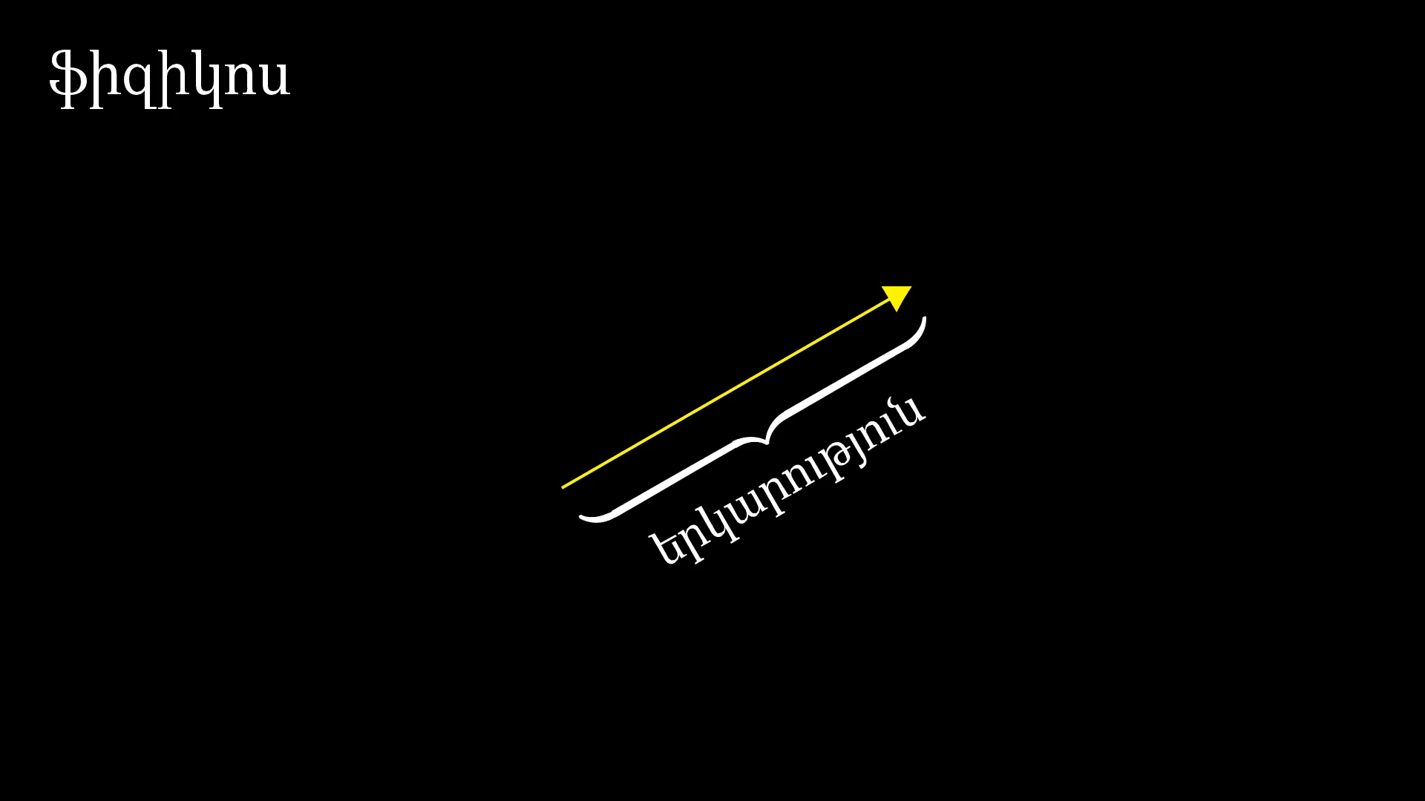
Notes:
Physicist conception

Slide 13
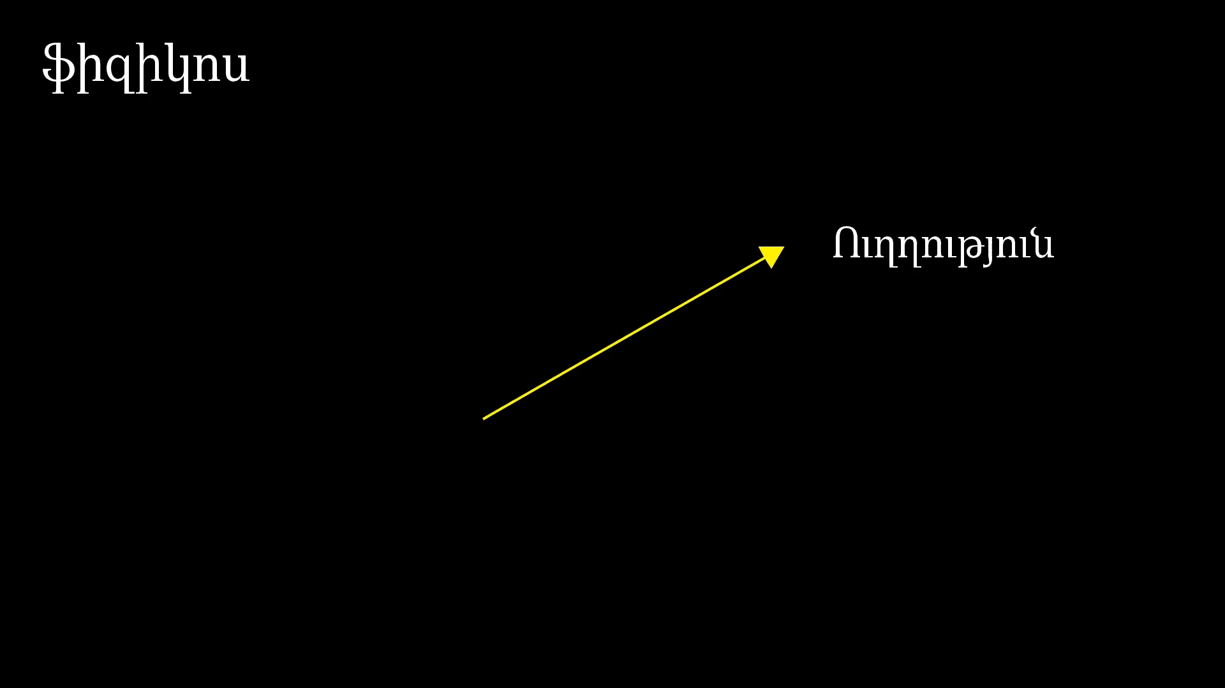
Notes:
Position doesn’t matter

Slide 14
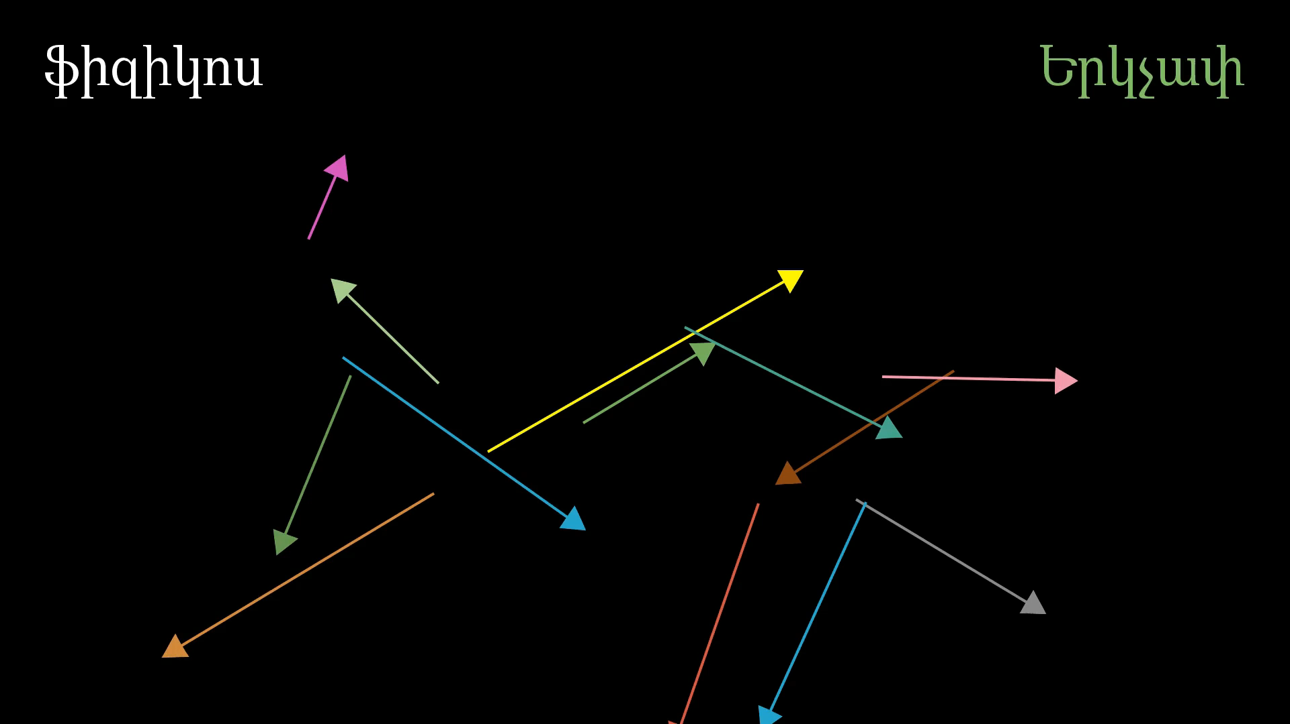
Notes:
CS conception

Slide 15
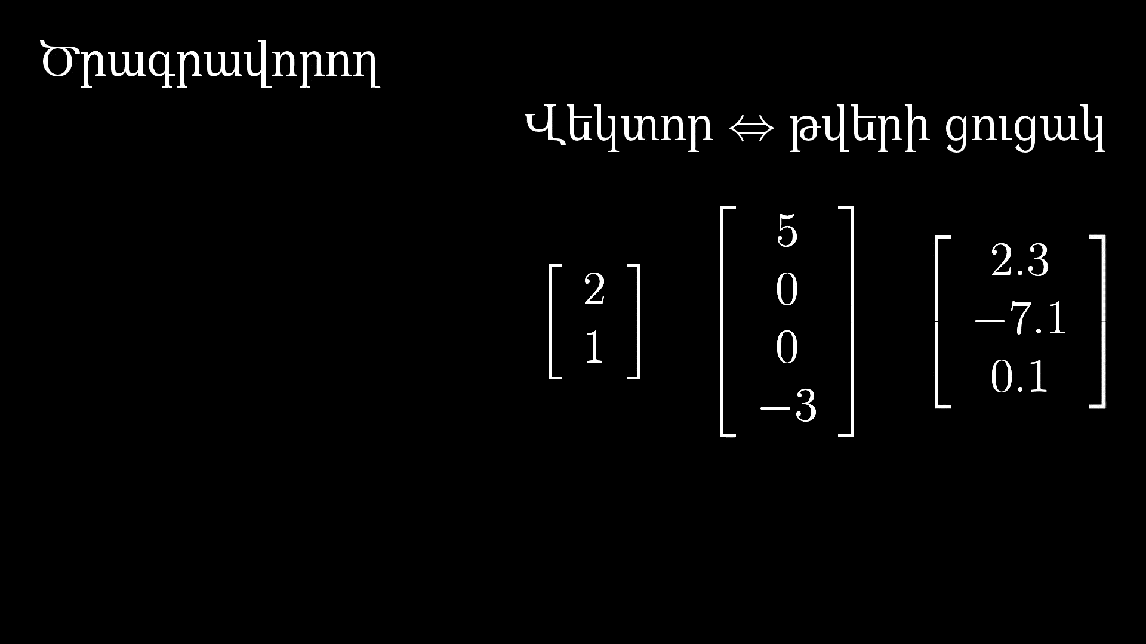
Notes:
Price and area

Slide 16
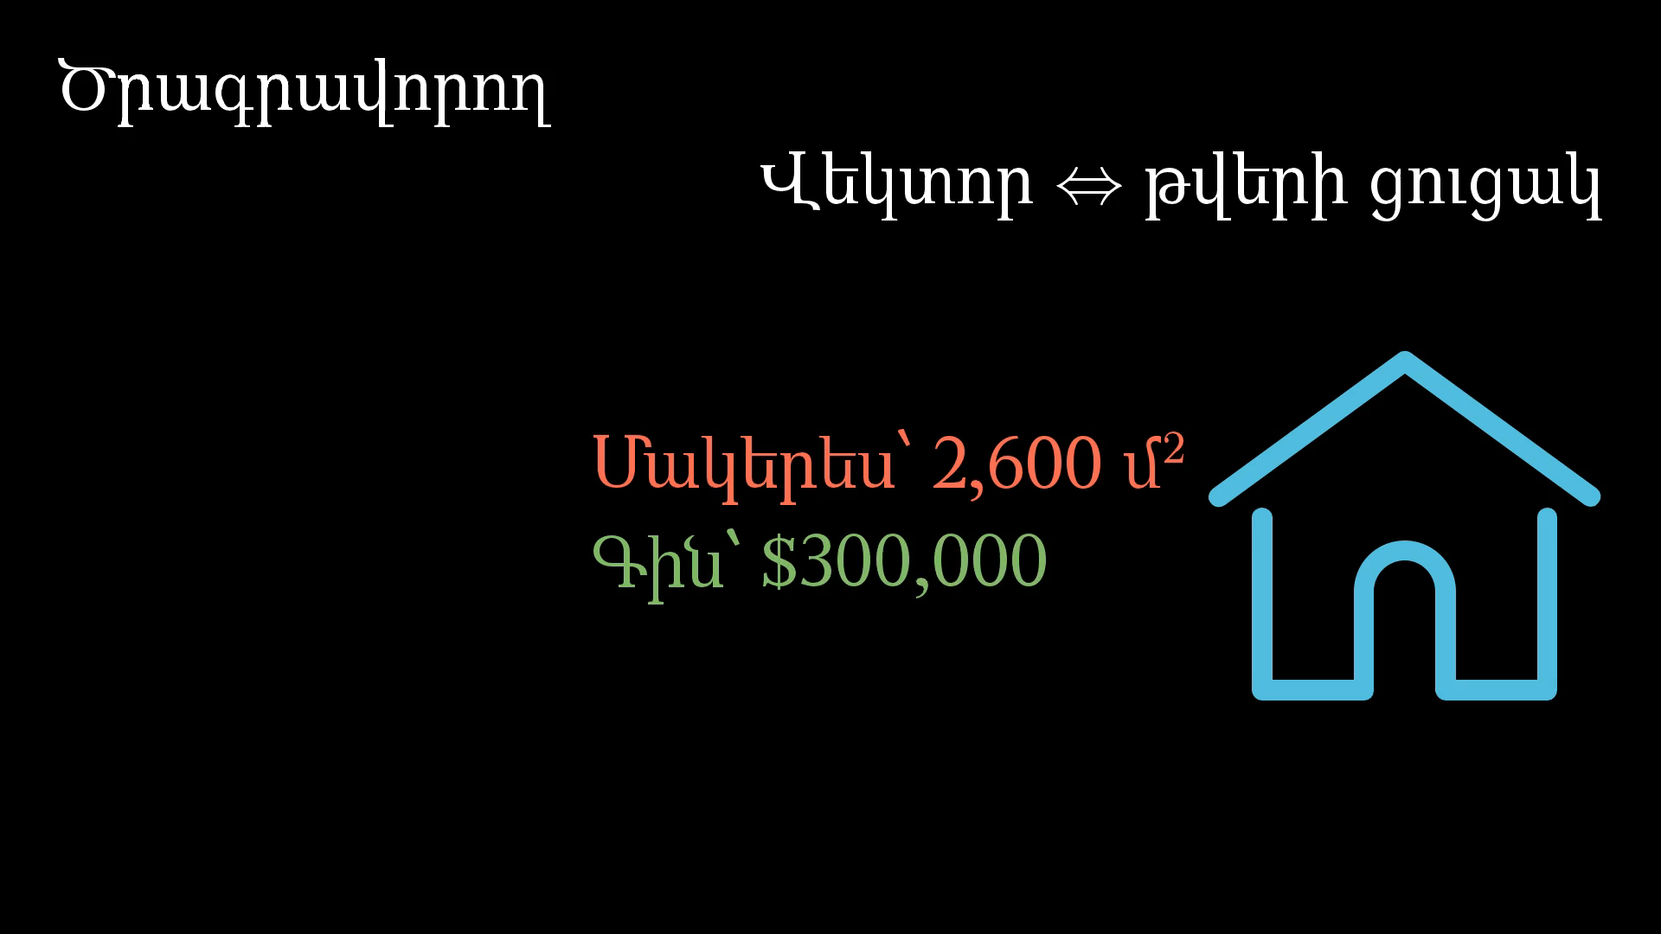
Notes:
As list

Slide 17
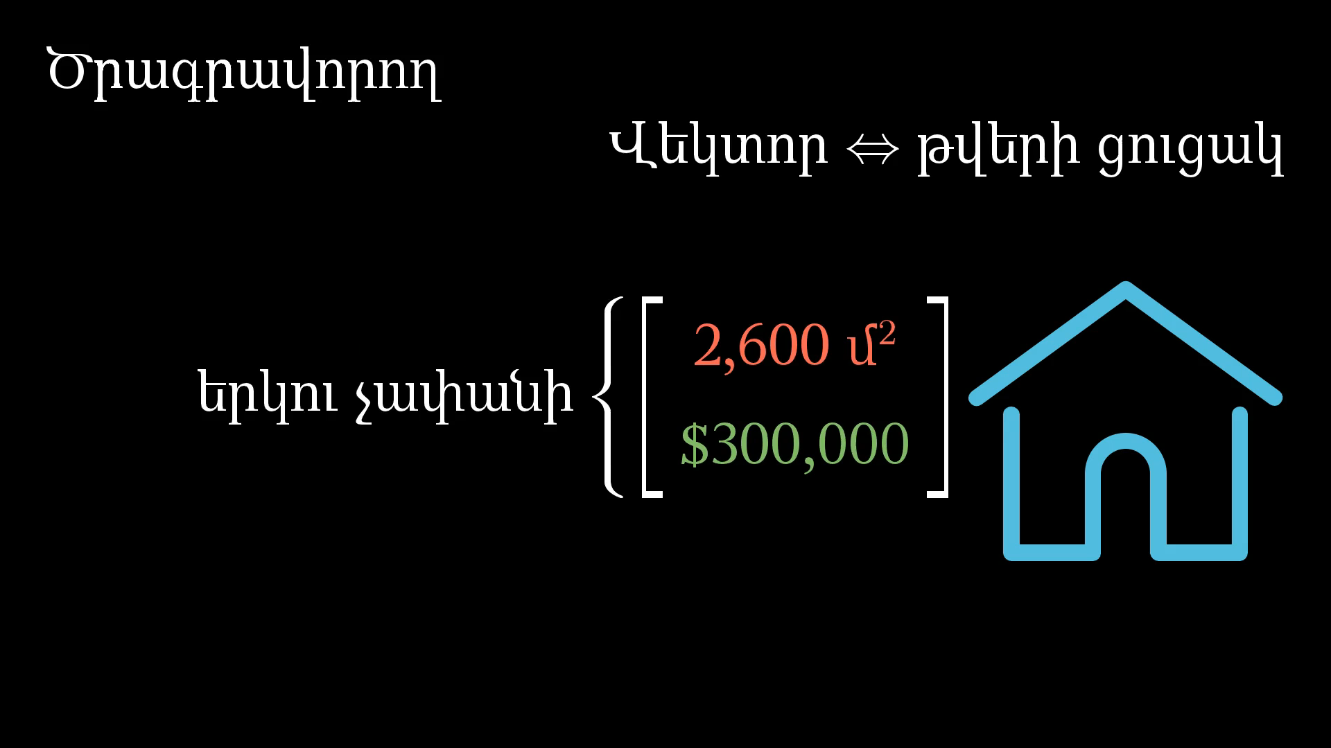
Notes:
mathematician

Slide 18
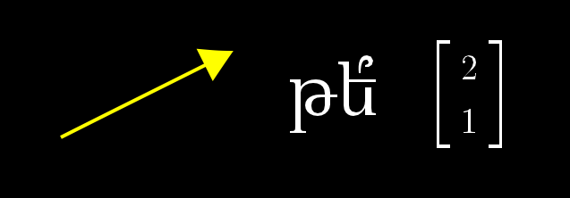
Մտածեք ինչ-որ վեկտորի մասին․․․
Notes:
Help to have one thought

Slide 19
Notes:
How I want you think about vector

Slide 20
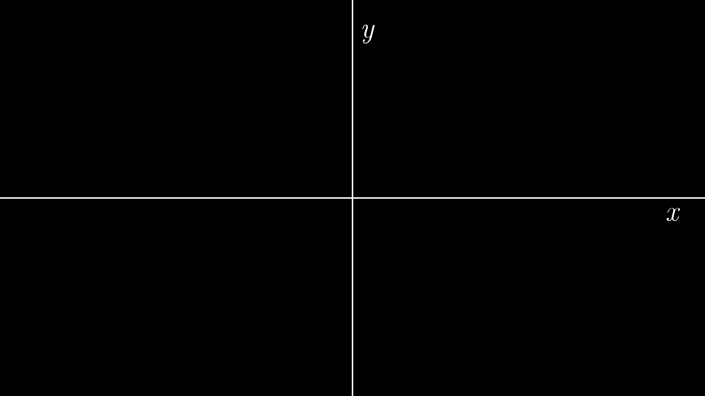
Notes:
Coordinate system

Slide 21
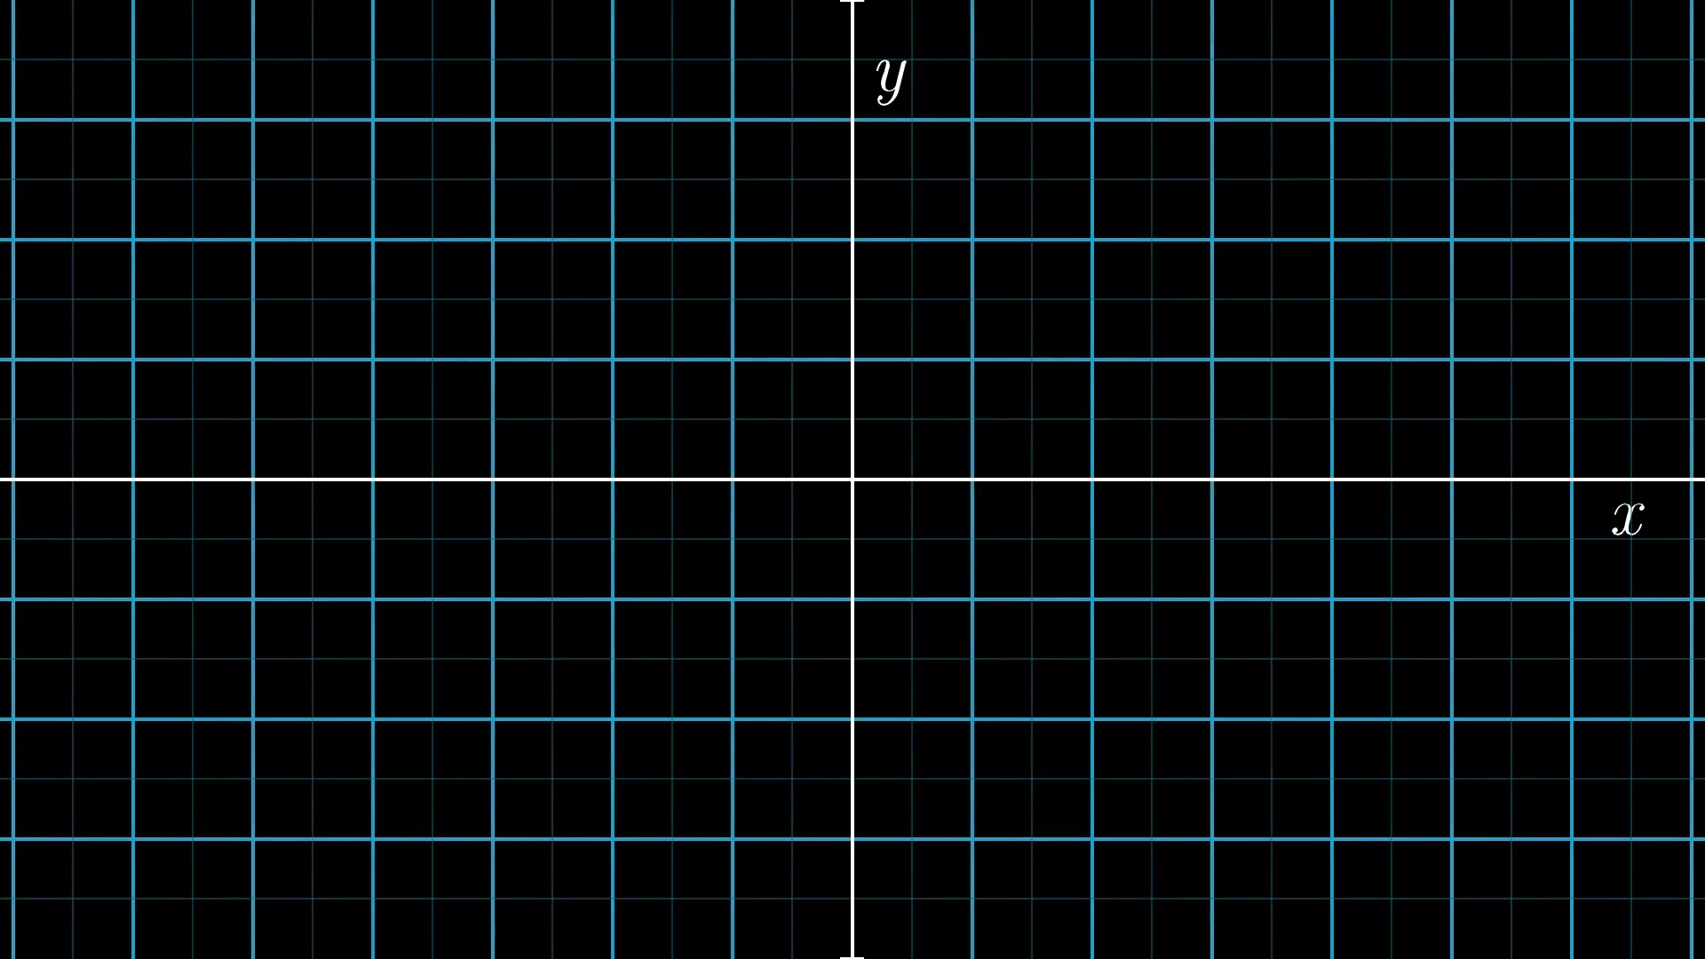
Notes:
Coordinates to vector

Slide 22
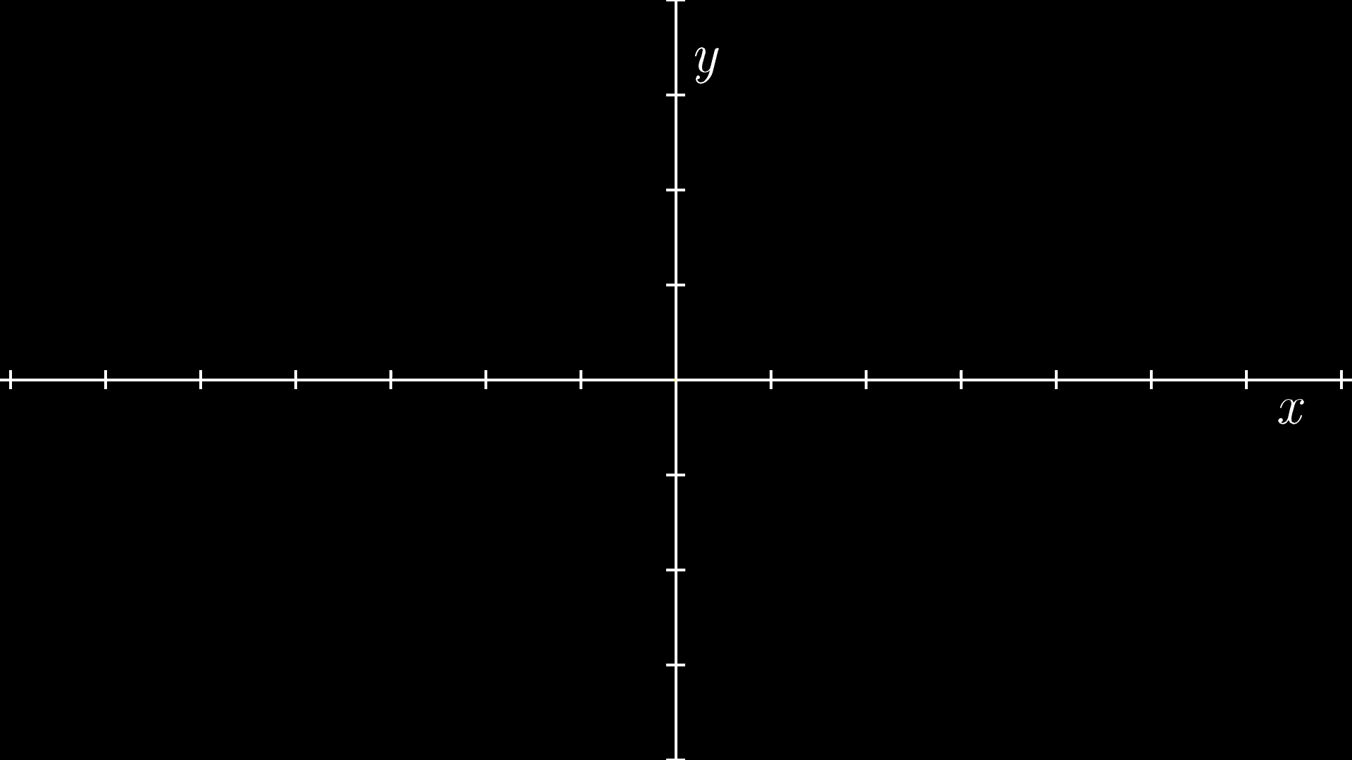
Notes:
Vector to coordinates

Slide 23
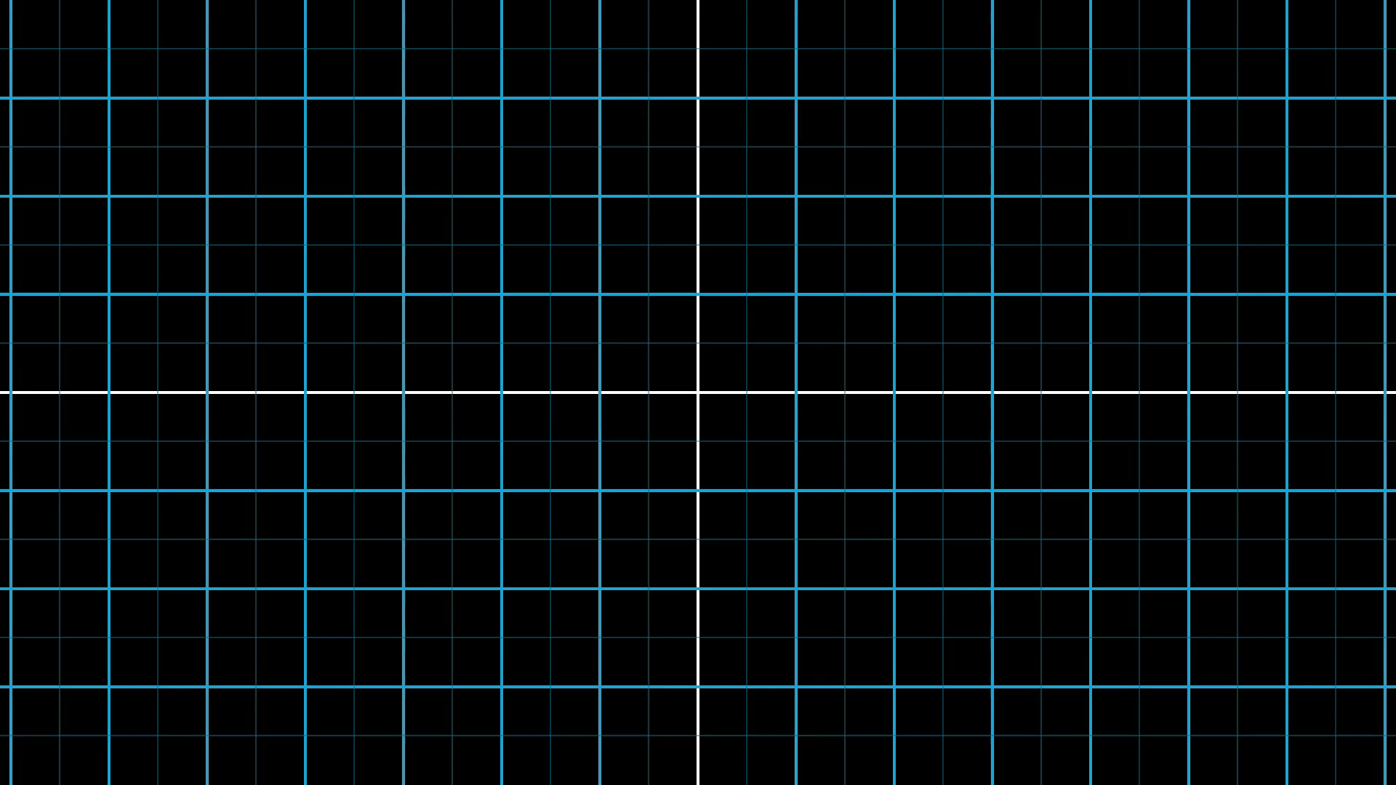

Slide 24
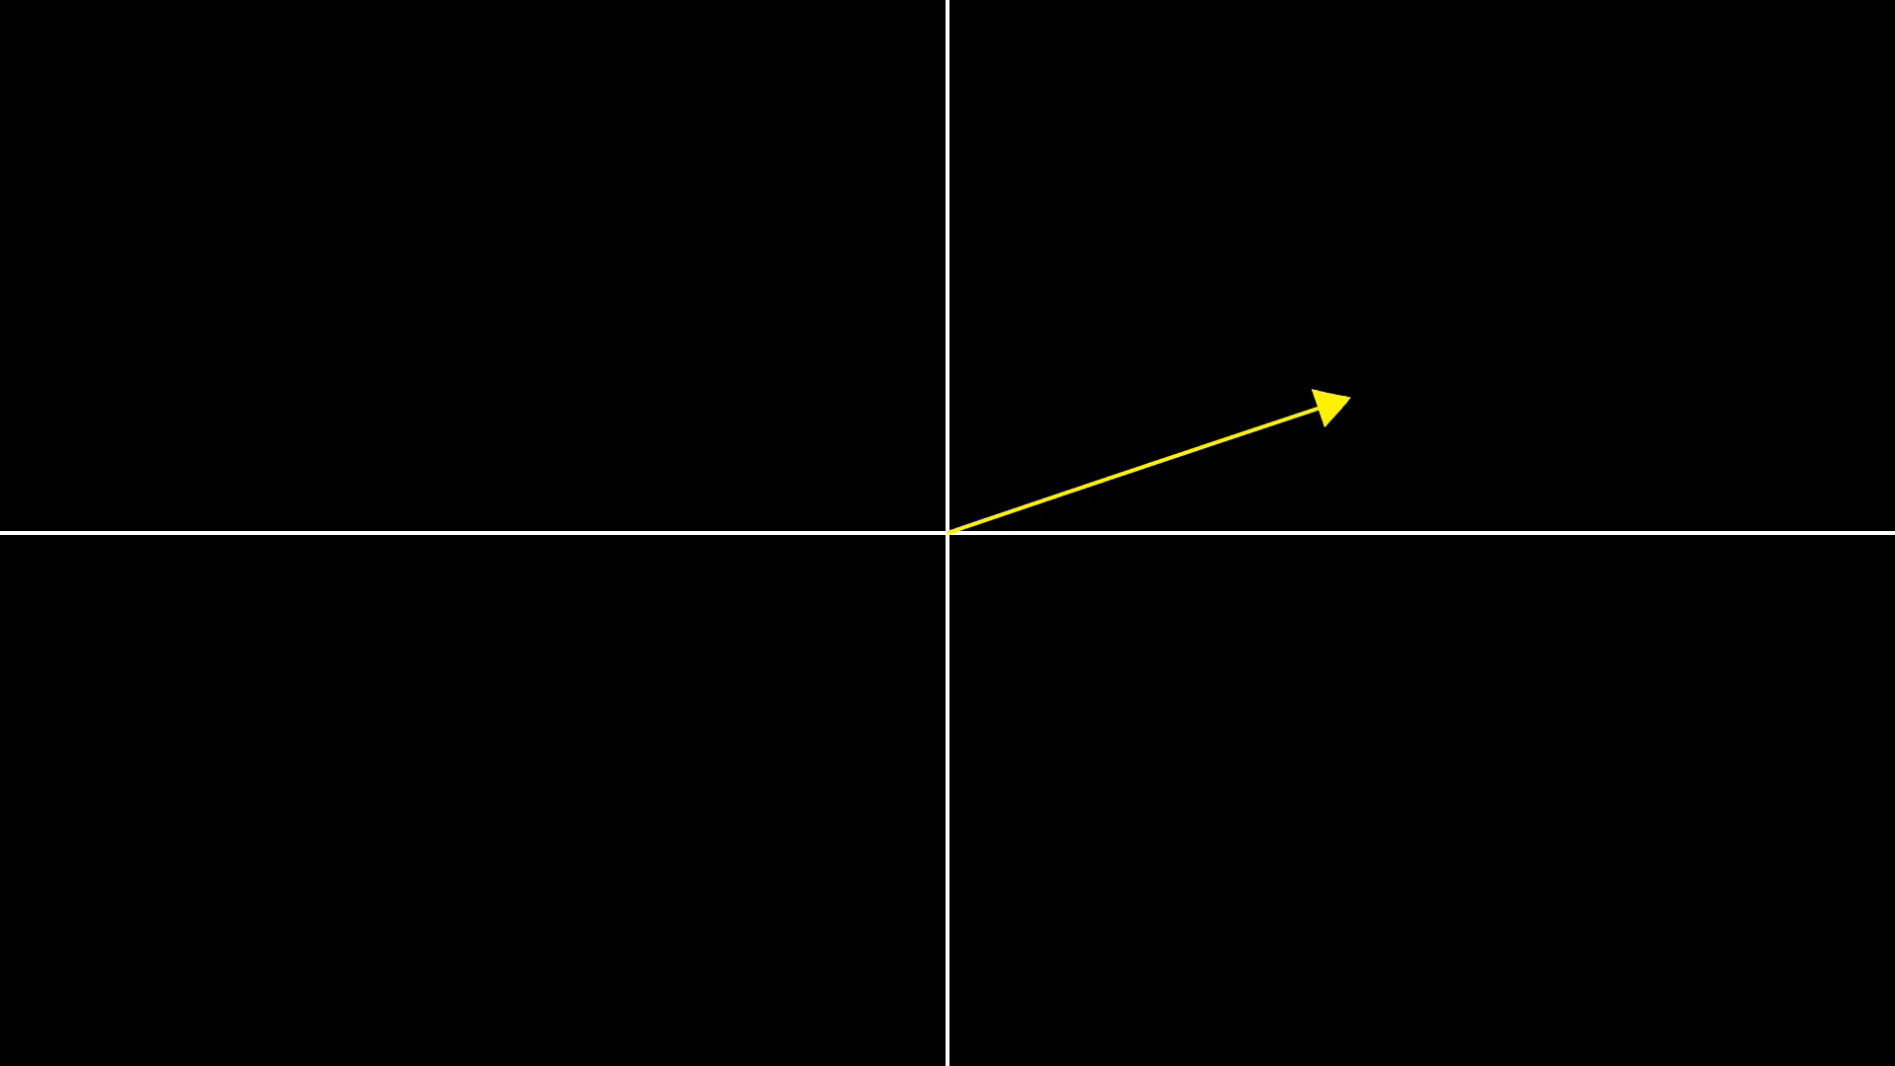

Slide 25
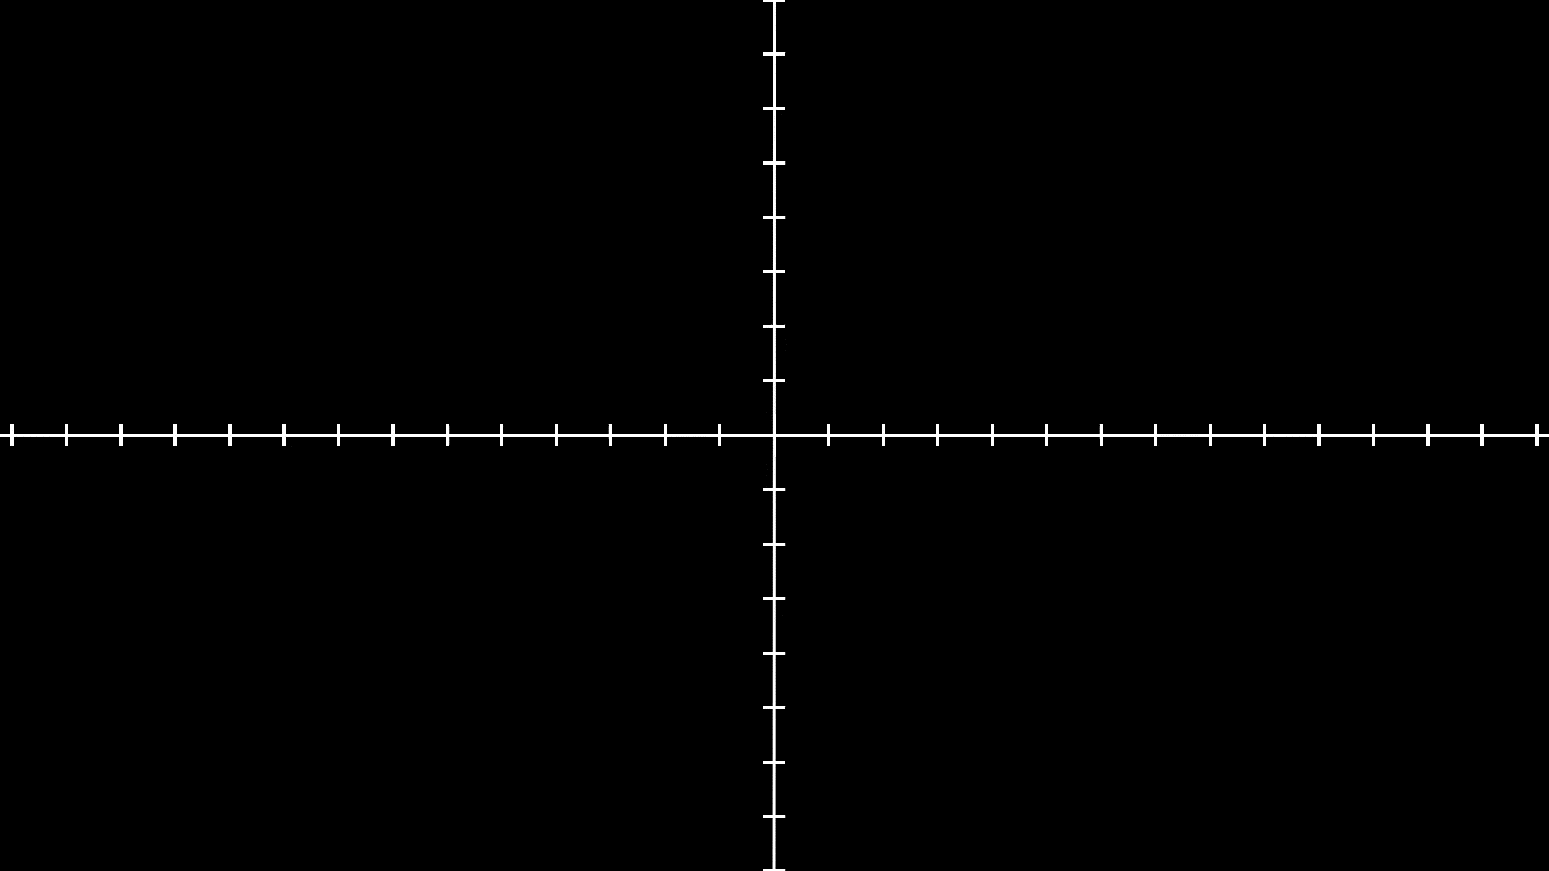
Notes:
Scalar multiplication numerically

Slide 26
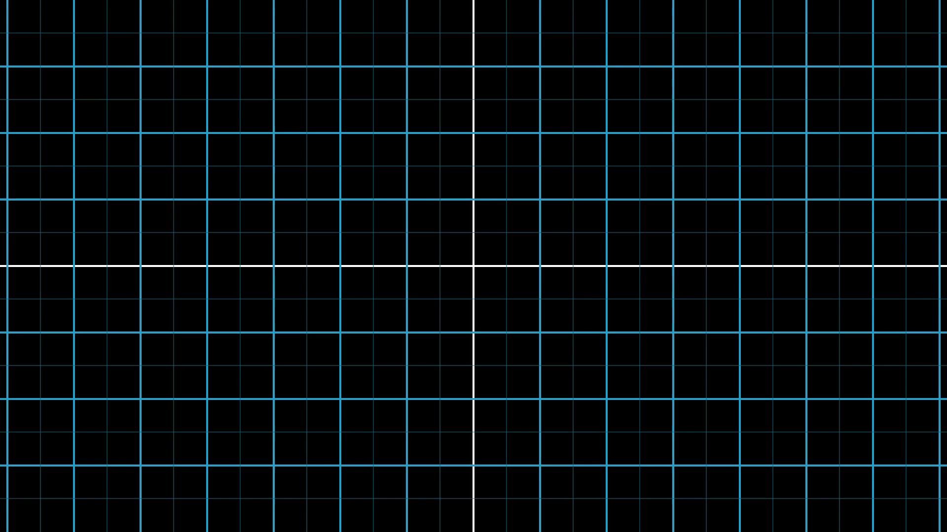
Notes:
Vector addition

Slide 27
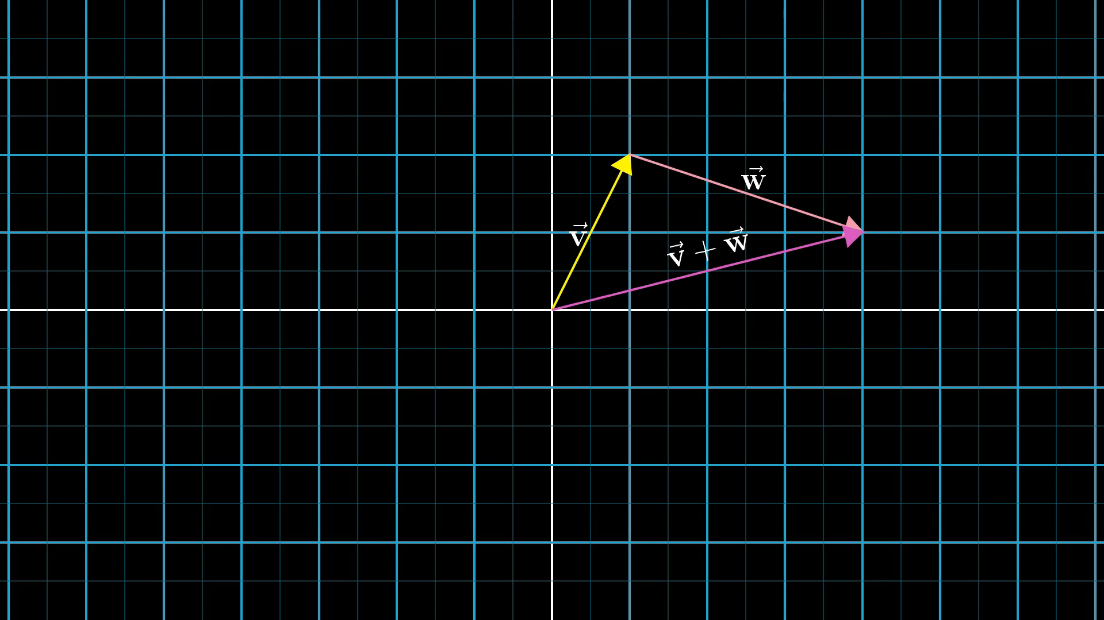
Notes:
Ask why

Slide 28
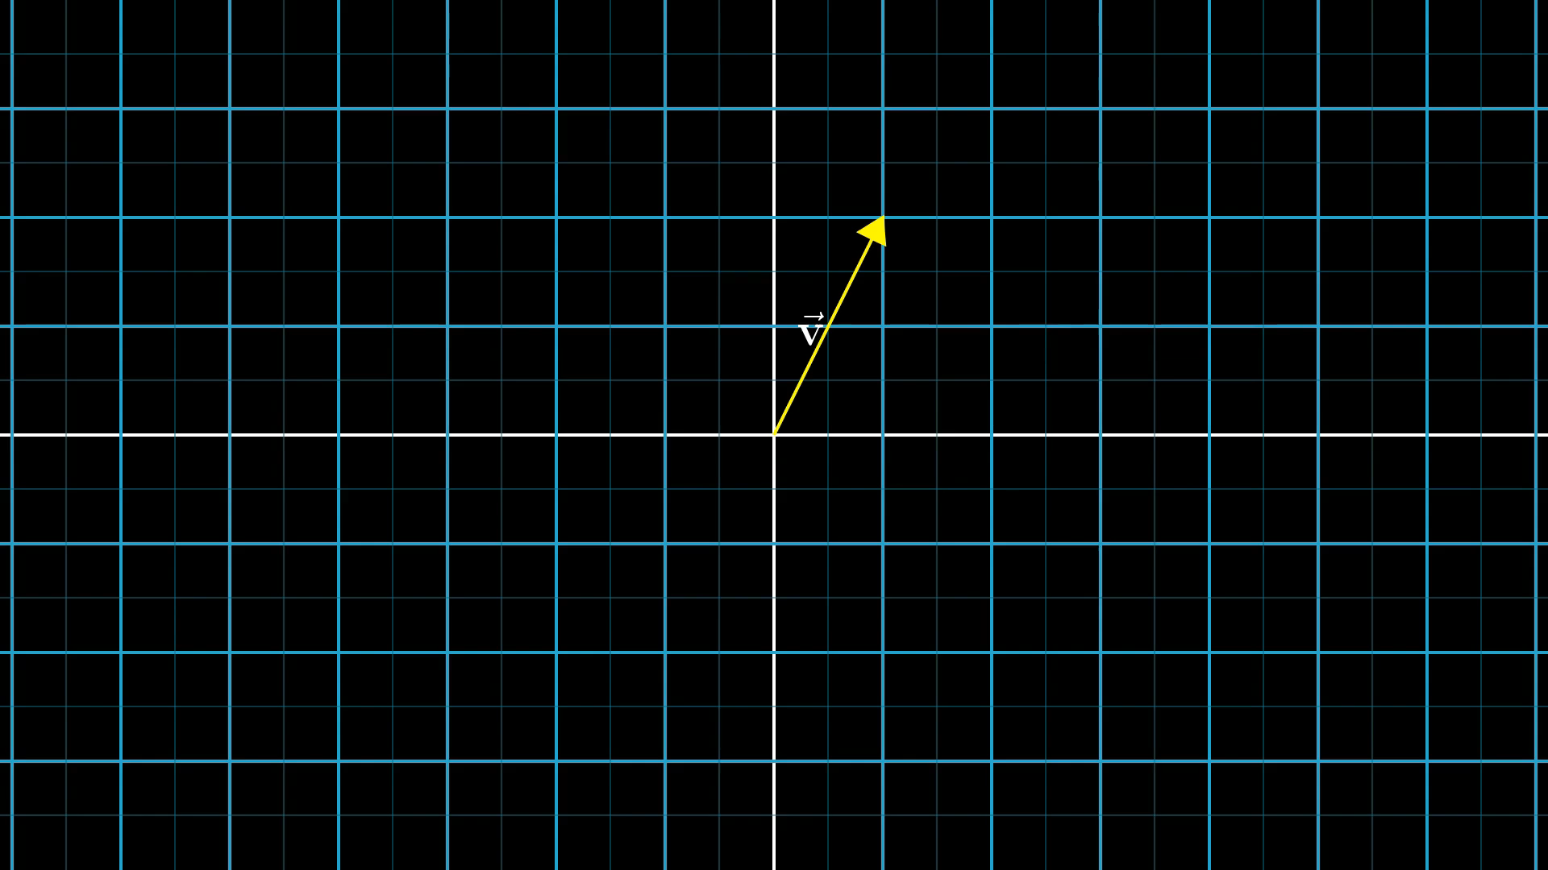
Notes:
Explain why

Slide 29
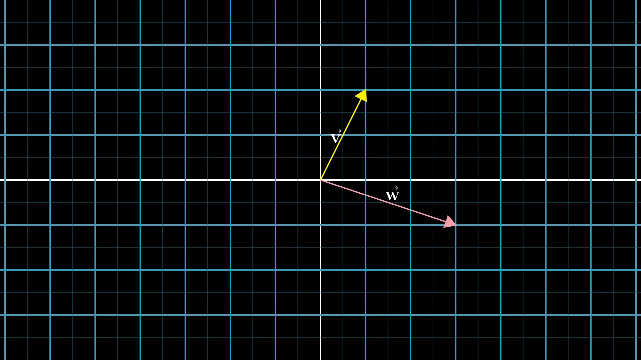
Notes:
Ball explanation

Slide 30
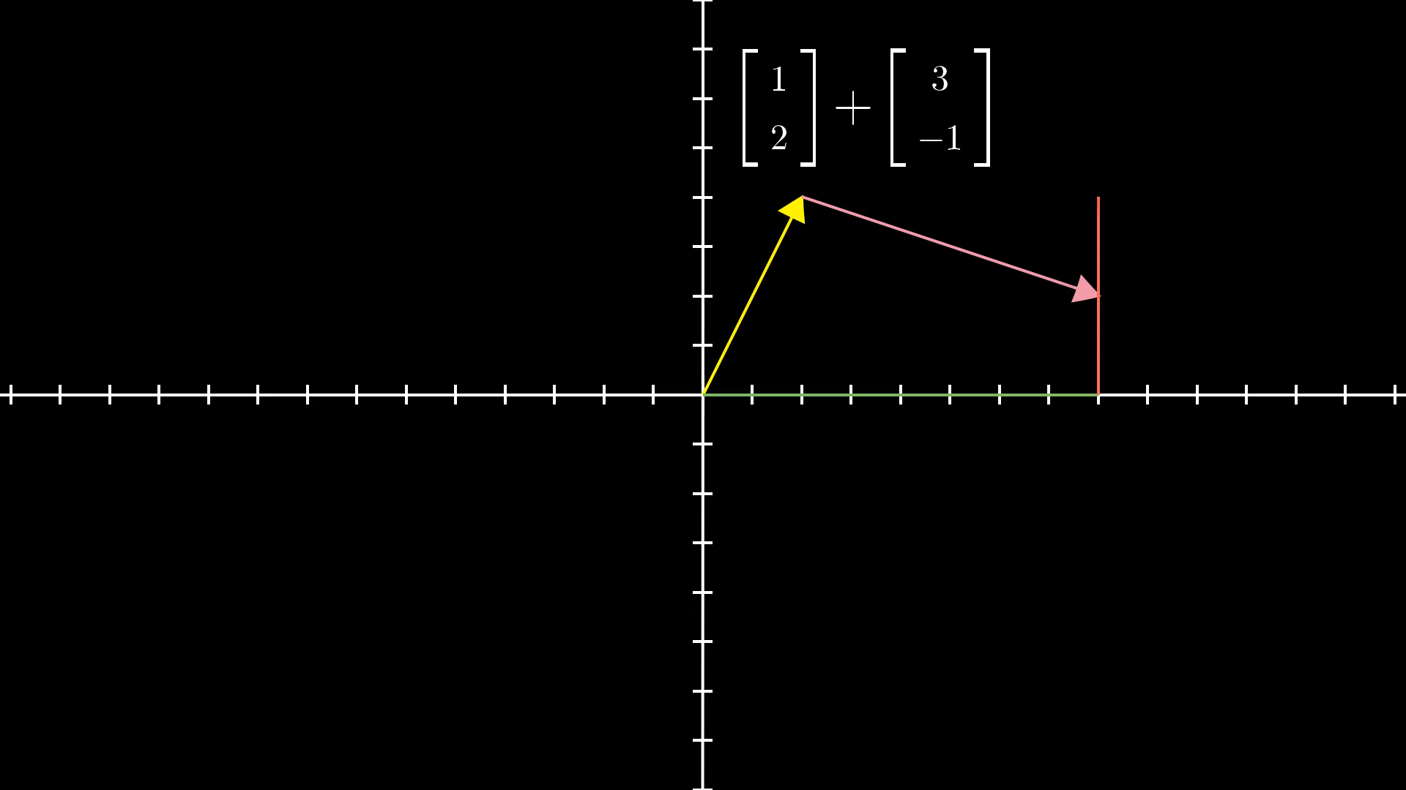

Slide 31
Notes:
It doesn’t matter which

Slide 32
Notes:
Data analyst

Slide 33
Notes:
Manipulate space

